Slide 1
Instance Aware Segmentation Update
Nick Trajkovski

Slide 2
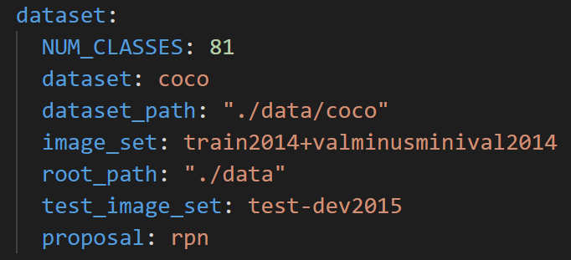
Steps to Get Training Working
Used 5 images for train & val from COCO set
Added our image to complete training
Completed training w/ 5 images for testing & validation
Issue: number of classes should be set to number of classes + 1
If we have only “helicopter” class NUM_CLASSES = 2
training+validation
testing set

Slide 3
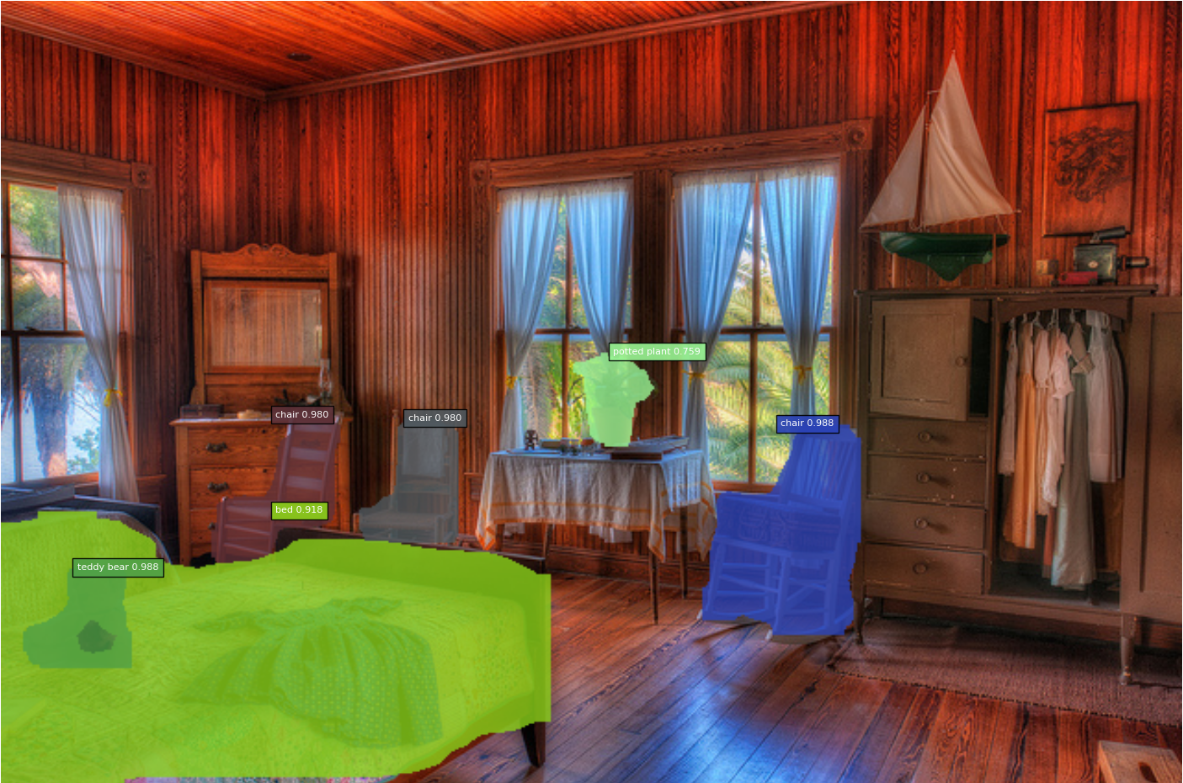
Pretrained Network

Slide 4
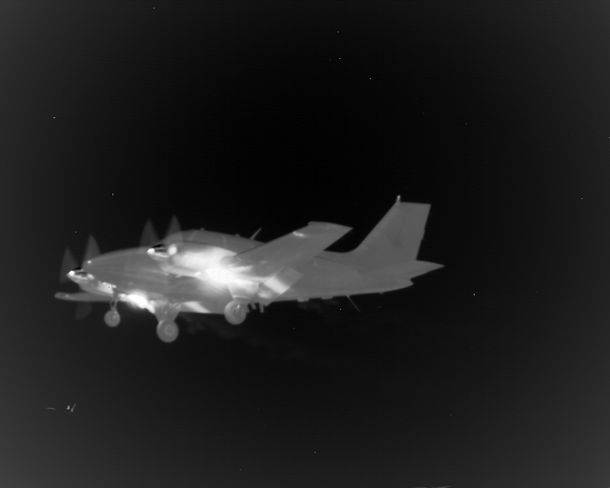
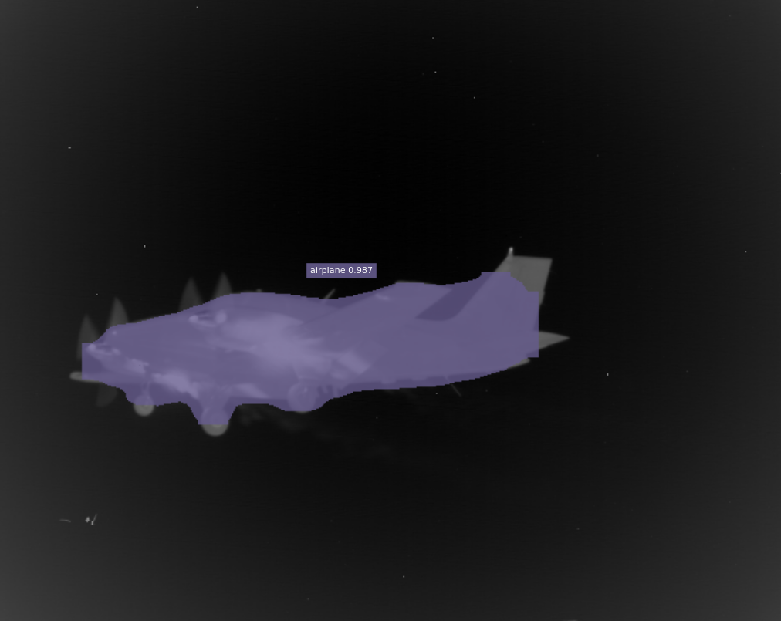
Testing our dataset w/ Pretrained Network

Slide 5
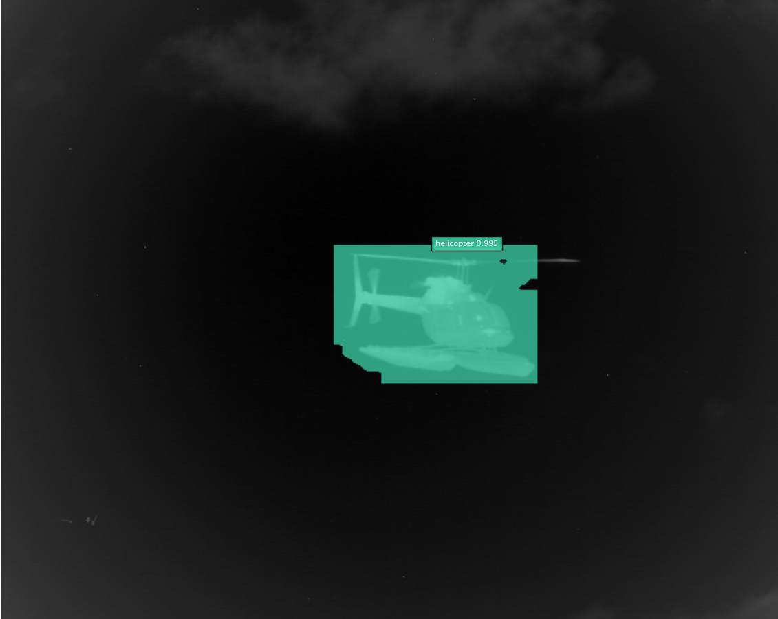
Our Dataset for 1000 Epoch
Finds target
Doesn’t segment

Slide 6

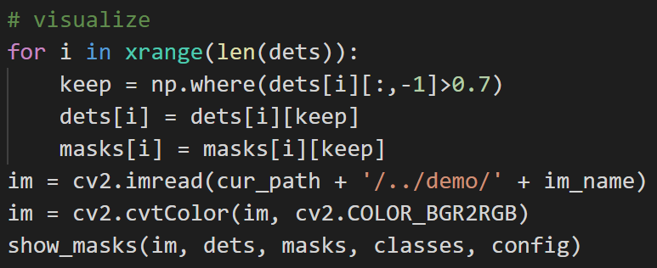
Our Dataset for 1000 Epoch: Mask Thresholding

Slide 7
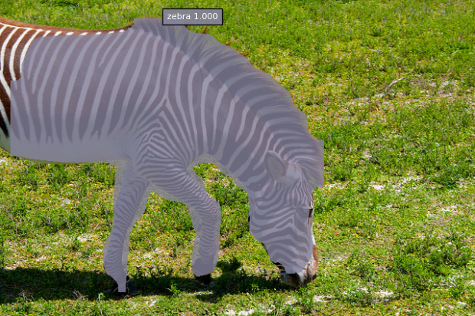
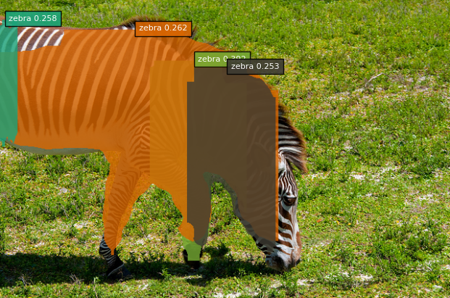
Retraining w/ Single Image
Pretrained Network
1 image for 1000 epochs
Also trained 1image from Prism dataset for 100 & 1000 epochs

Slide 8
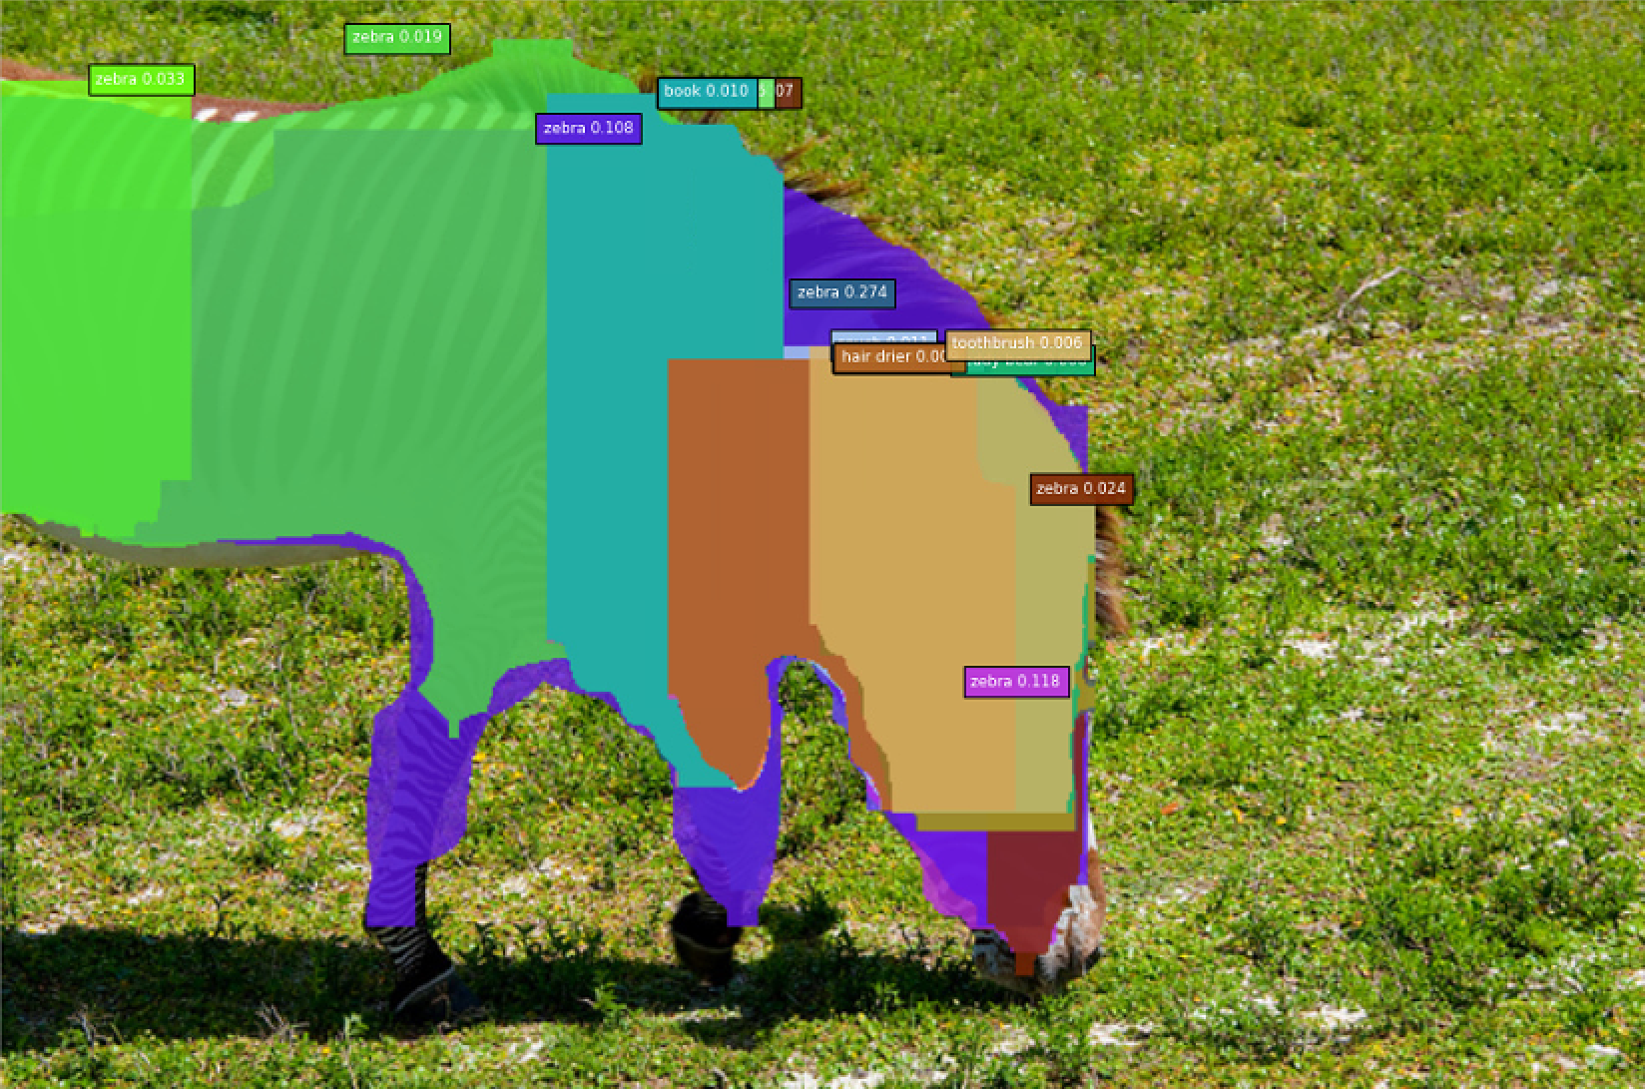
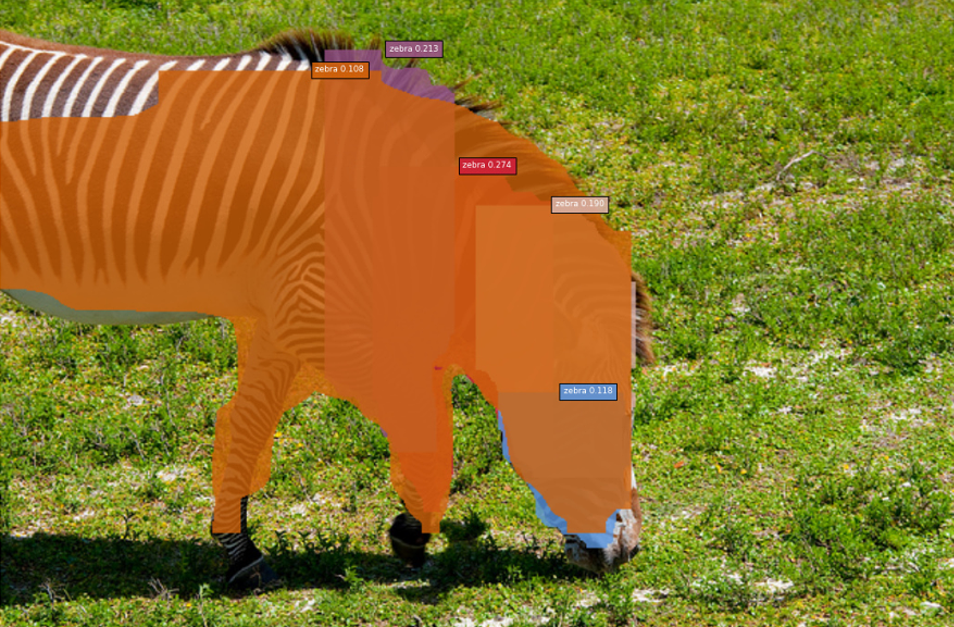
Retraining w/ Single Image: 5000 epochs
1 image for 1000 epochs
1 image for 5000 epochs

Slide 9
Next Steps: For Monday
Details on implementation
More results
Guide on usage

